Slide 1
Tetranucleotide Usage in Mycobacteriophage Genomes
alignment-free methods to cluster phage and infer evolutionary relationships
CHEN YE benjamin siranosian | emma herold | minjae kwon | sudheesha perera edward williams | sarah taylor | christopher degraffenreid
all the things are preliminary + subject to change

Slide 2
Introduction + Background

Slide 3
Construct phylogenetic tree
Categorize phage into subclusters
Identify anomalies

Slide 4
TUDs

Slide 5
(normally, a pretty informative animation would be here)
but it’s not done yet :-(

Slide 6
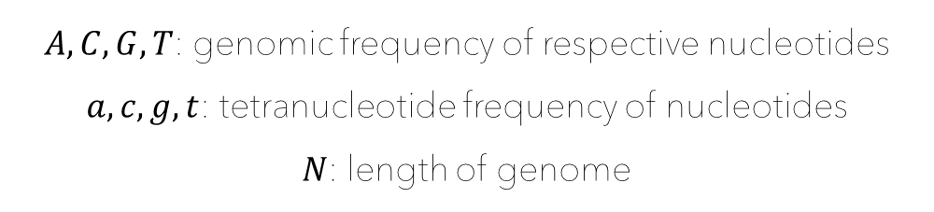

$$E\left(w\right)=[\left(A^{a}∗C^{c}∗G^{g}∗T^{t}\right)∗N−3]$$
$A, C, G, T$: genomic frequency of respective nucleotides
$a, c, g, t$: tetranucleotide frequency of nucleotides
$N$: length of genome

Slide 7

$$T(w)=\frac{observed}{expected}$$

Slide 8
Hierarchical Clustering + Neighbor Joining

Slide 9
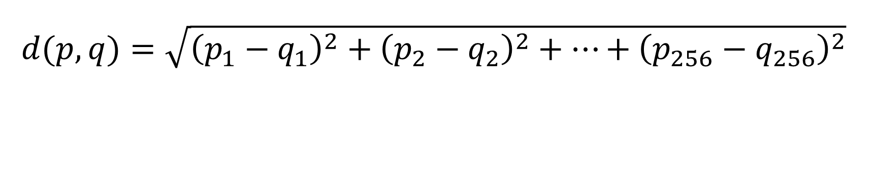
$$d(p,q)=\sqrt{{\left(p_{1}−q_{1}\right)}^{2}+{\left(p_{2}−q_{2}\right)}^{2}+…+{\left(p_{256}−q_{256}\right)}^{2}}$$

Slide 10
(normally, a pretty informative animation would be here)
but it’s not done yet :-(

Slide 11
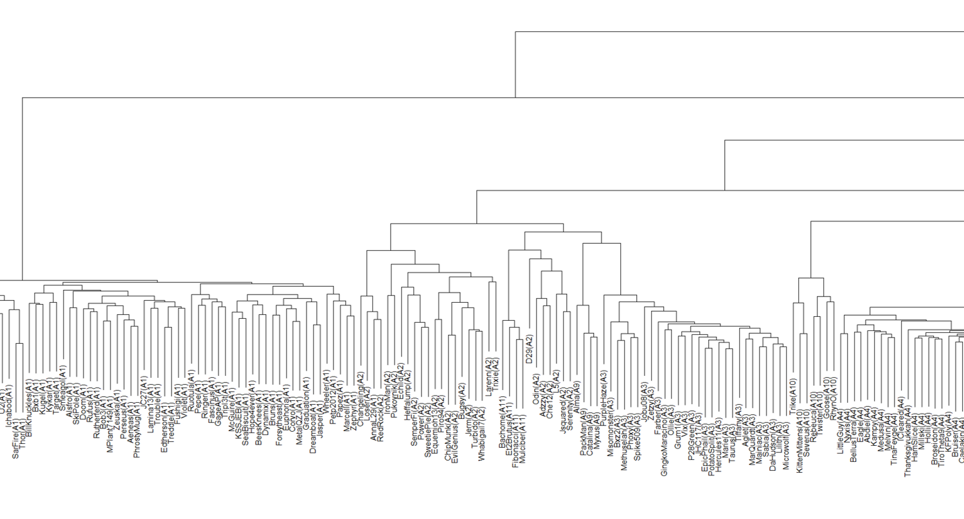

Slide 12
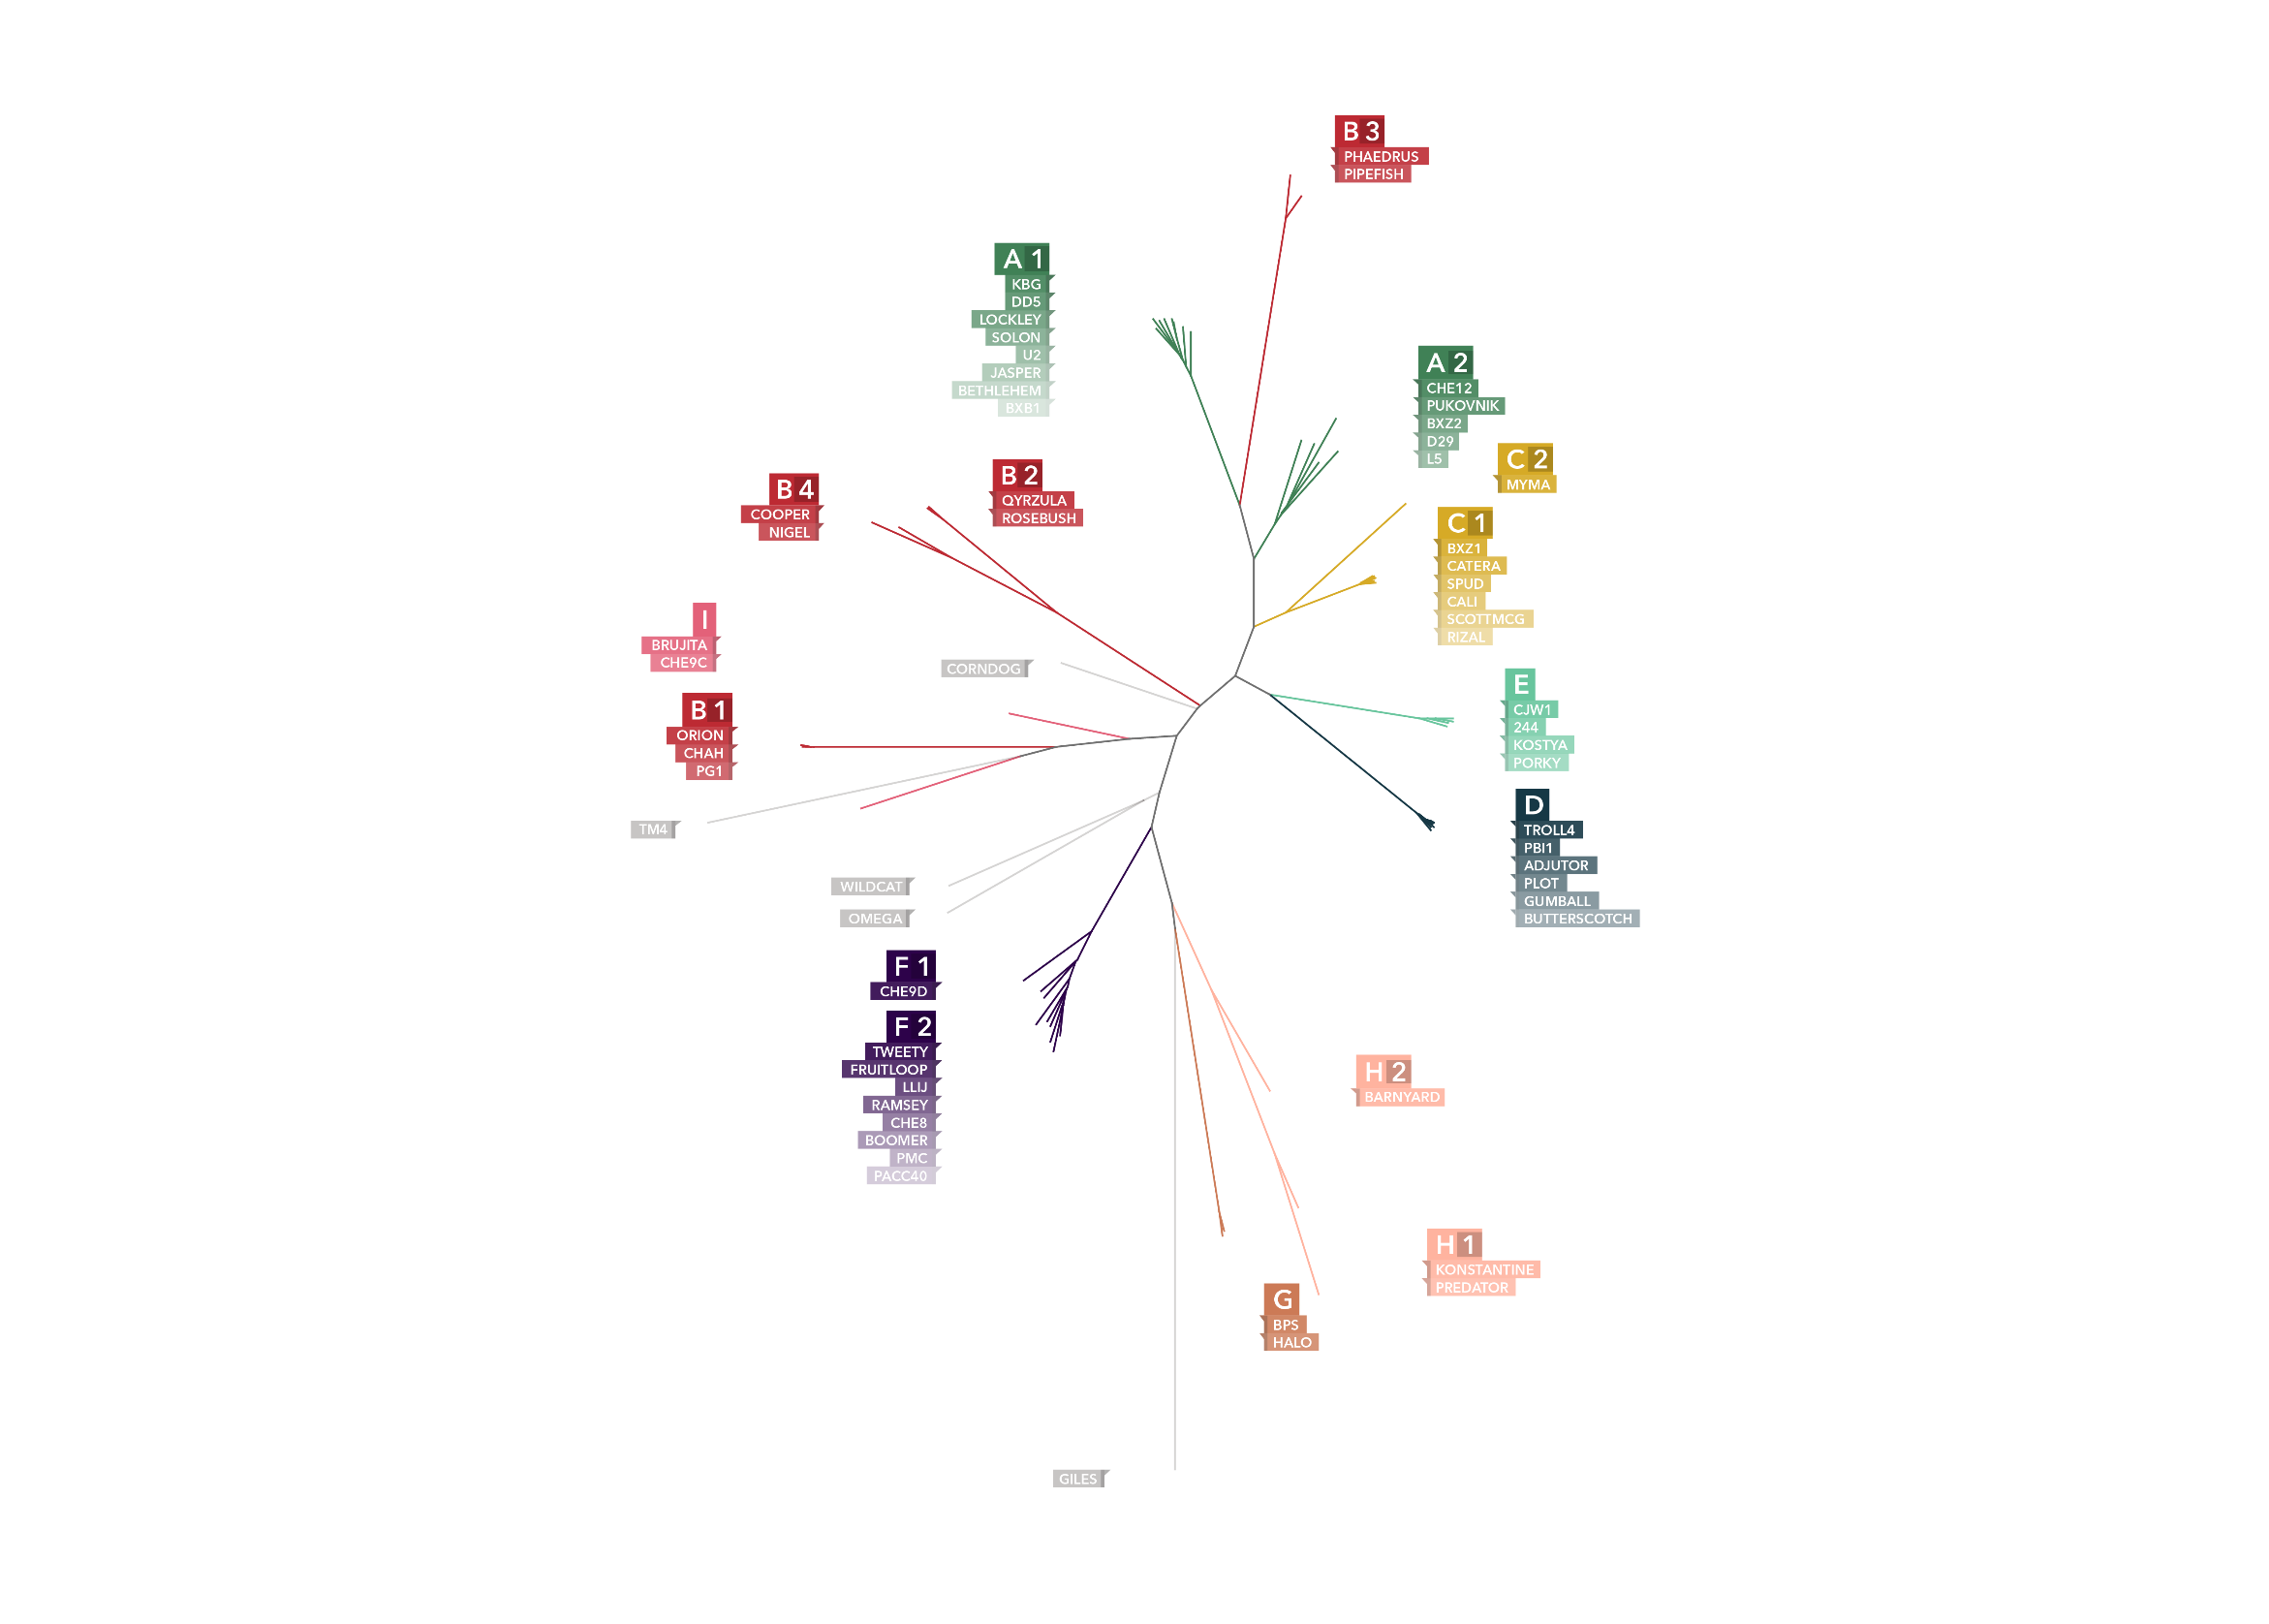

Slide 13
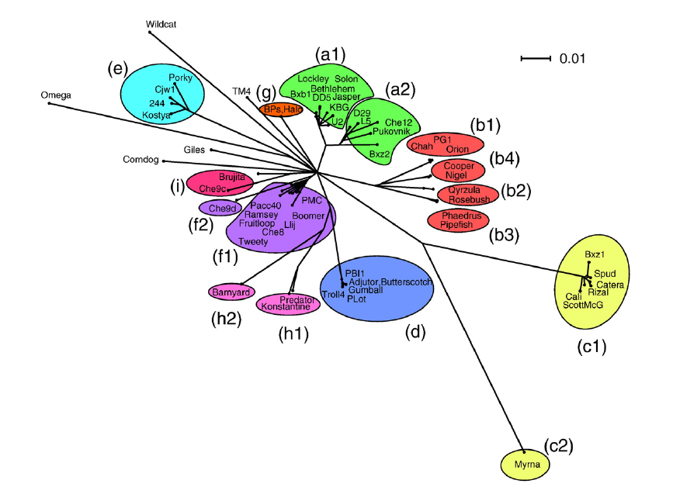

Slide 17
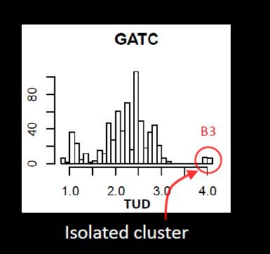
(preliminary graphic)

Slide 18
B3 figures here

Slide 19
KNN Classifier

Slide 20
Correctly Classified Instances: 641 98.0122% Incorrectly Classified Instances: 13 1.9878 %

Slide 21
Tetranucleotide Difference Index

Slide 22
(normally, a pretty informative animation would be here)
but it’s not done yet :-(

Slide 23

$$\sum_{j}^{i}{|T−T_{w}\left(W\right)|}$$

Slide 24
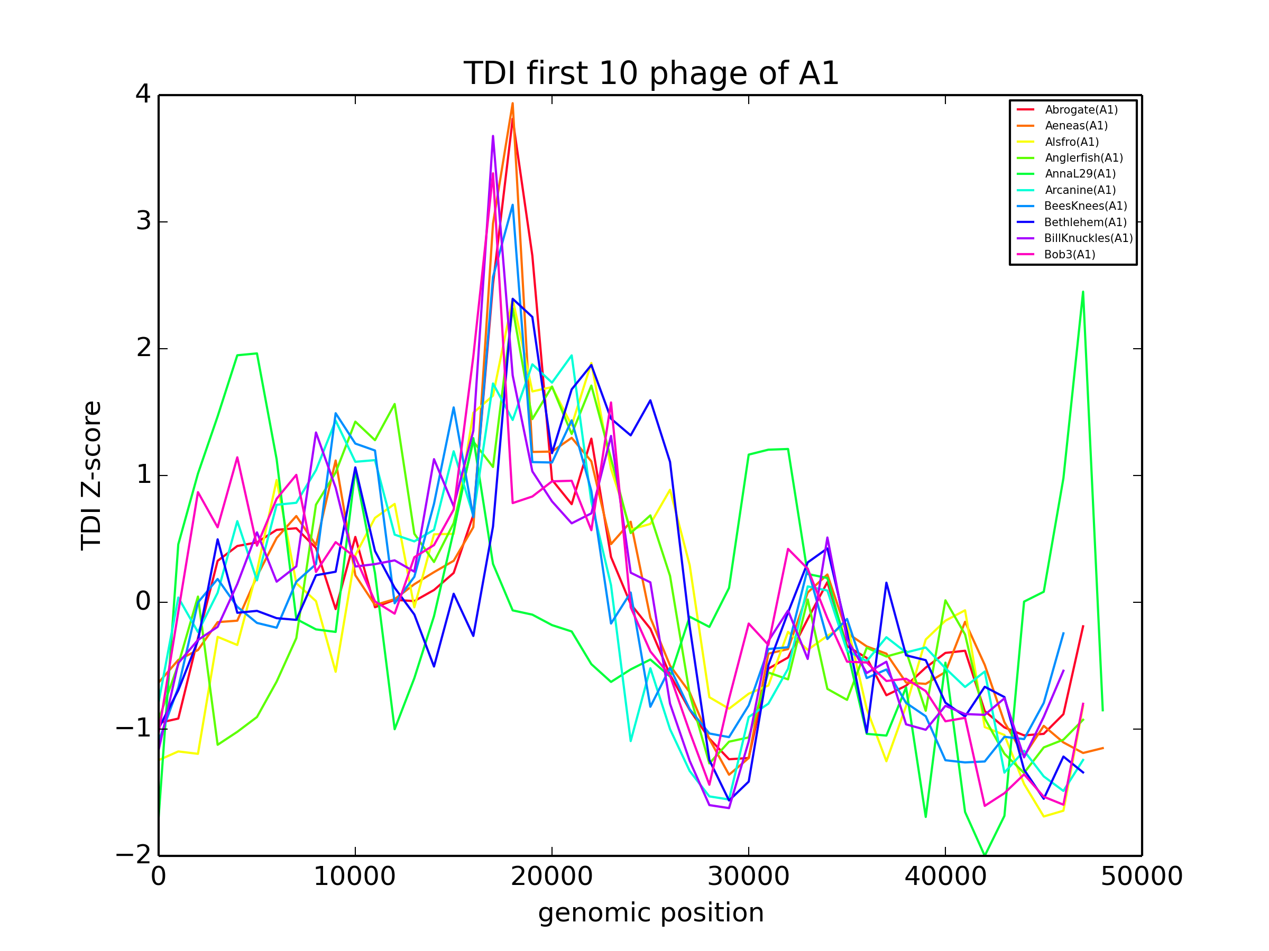

Slide 25
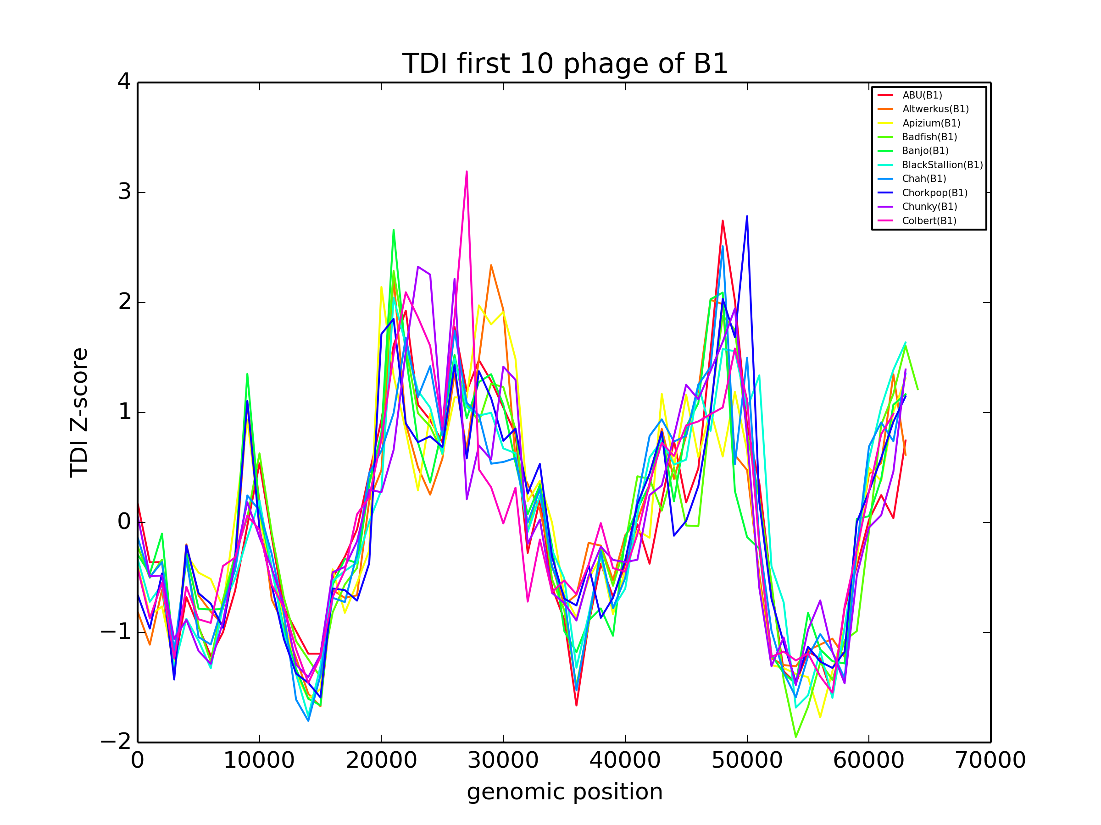

Slide 26
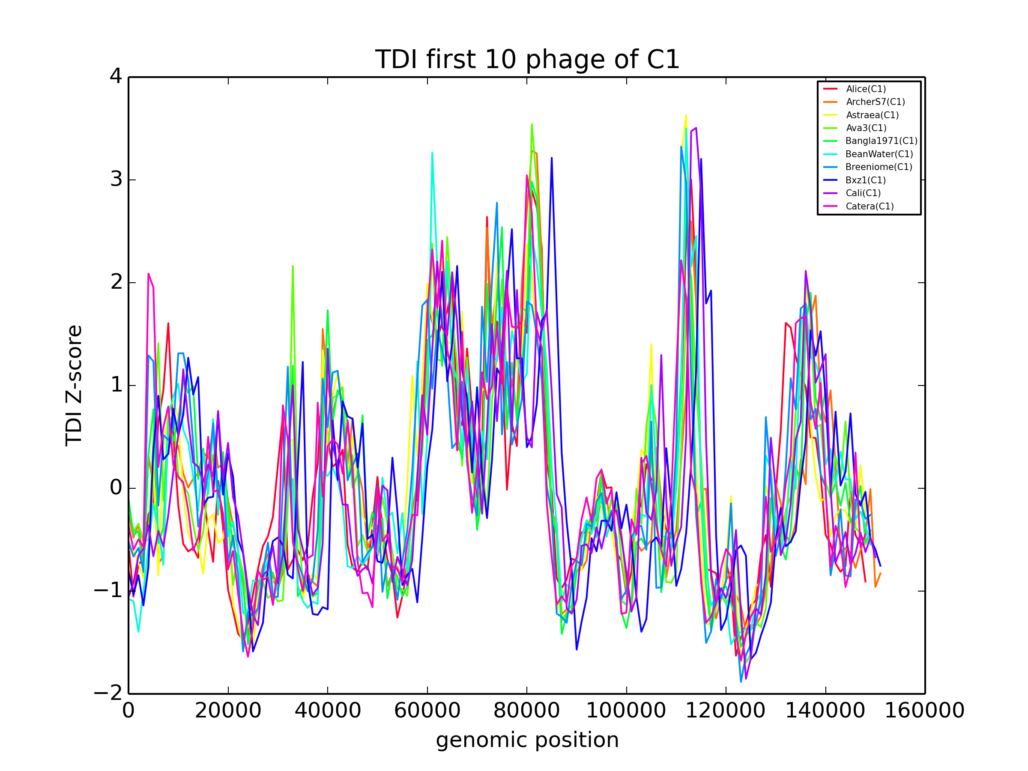

Slide 27
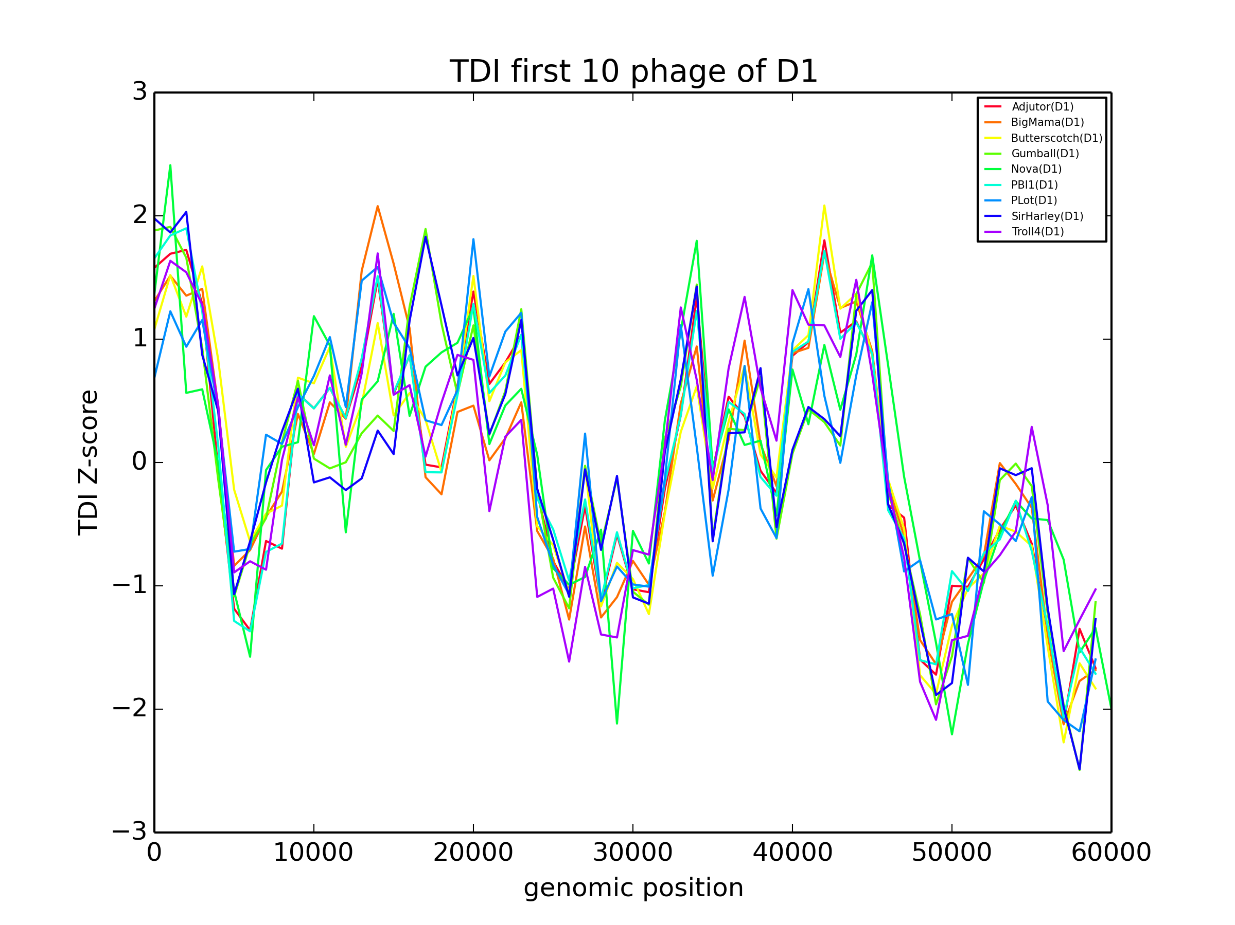

Slide 28
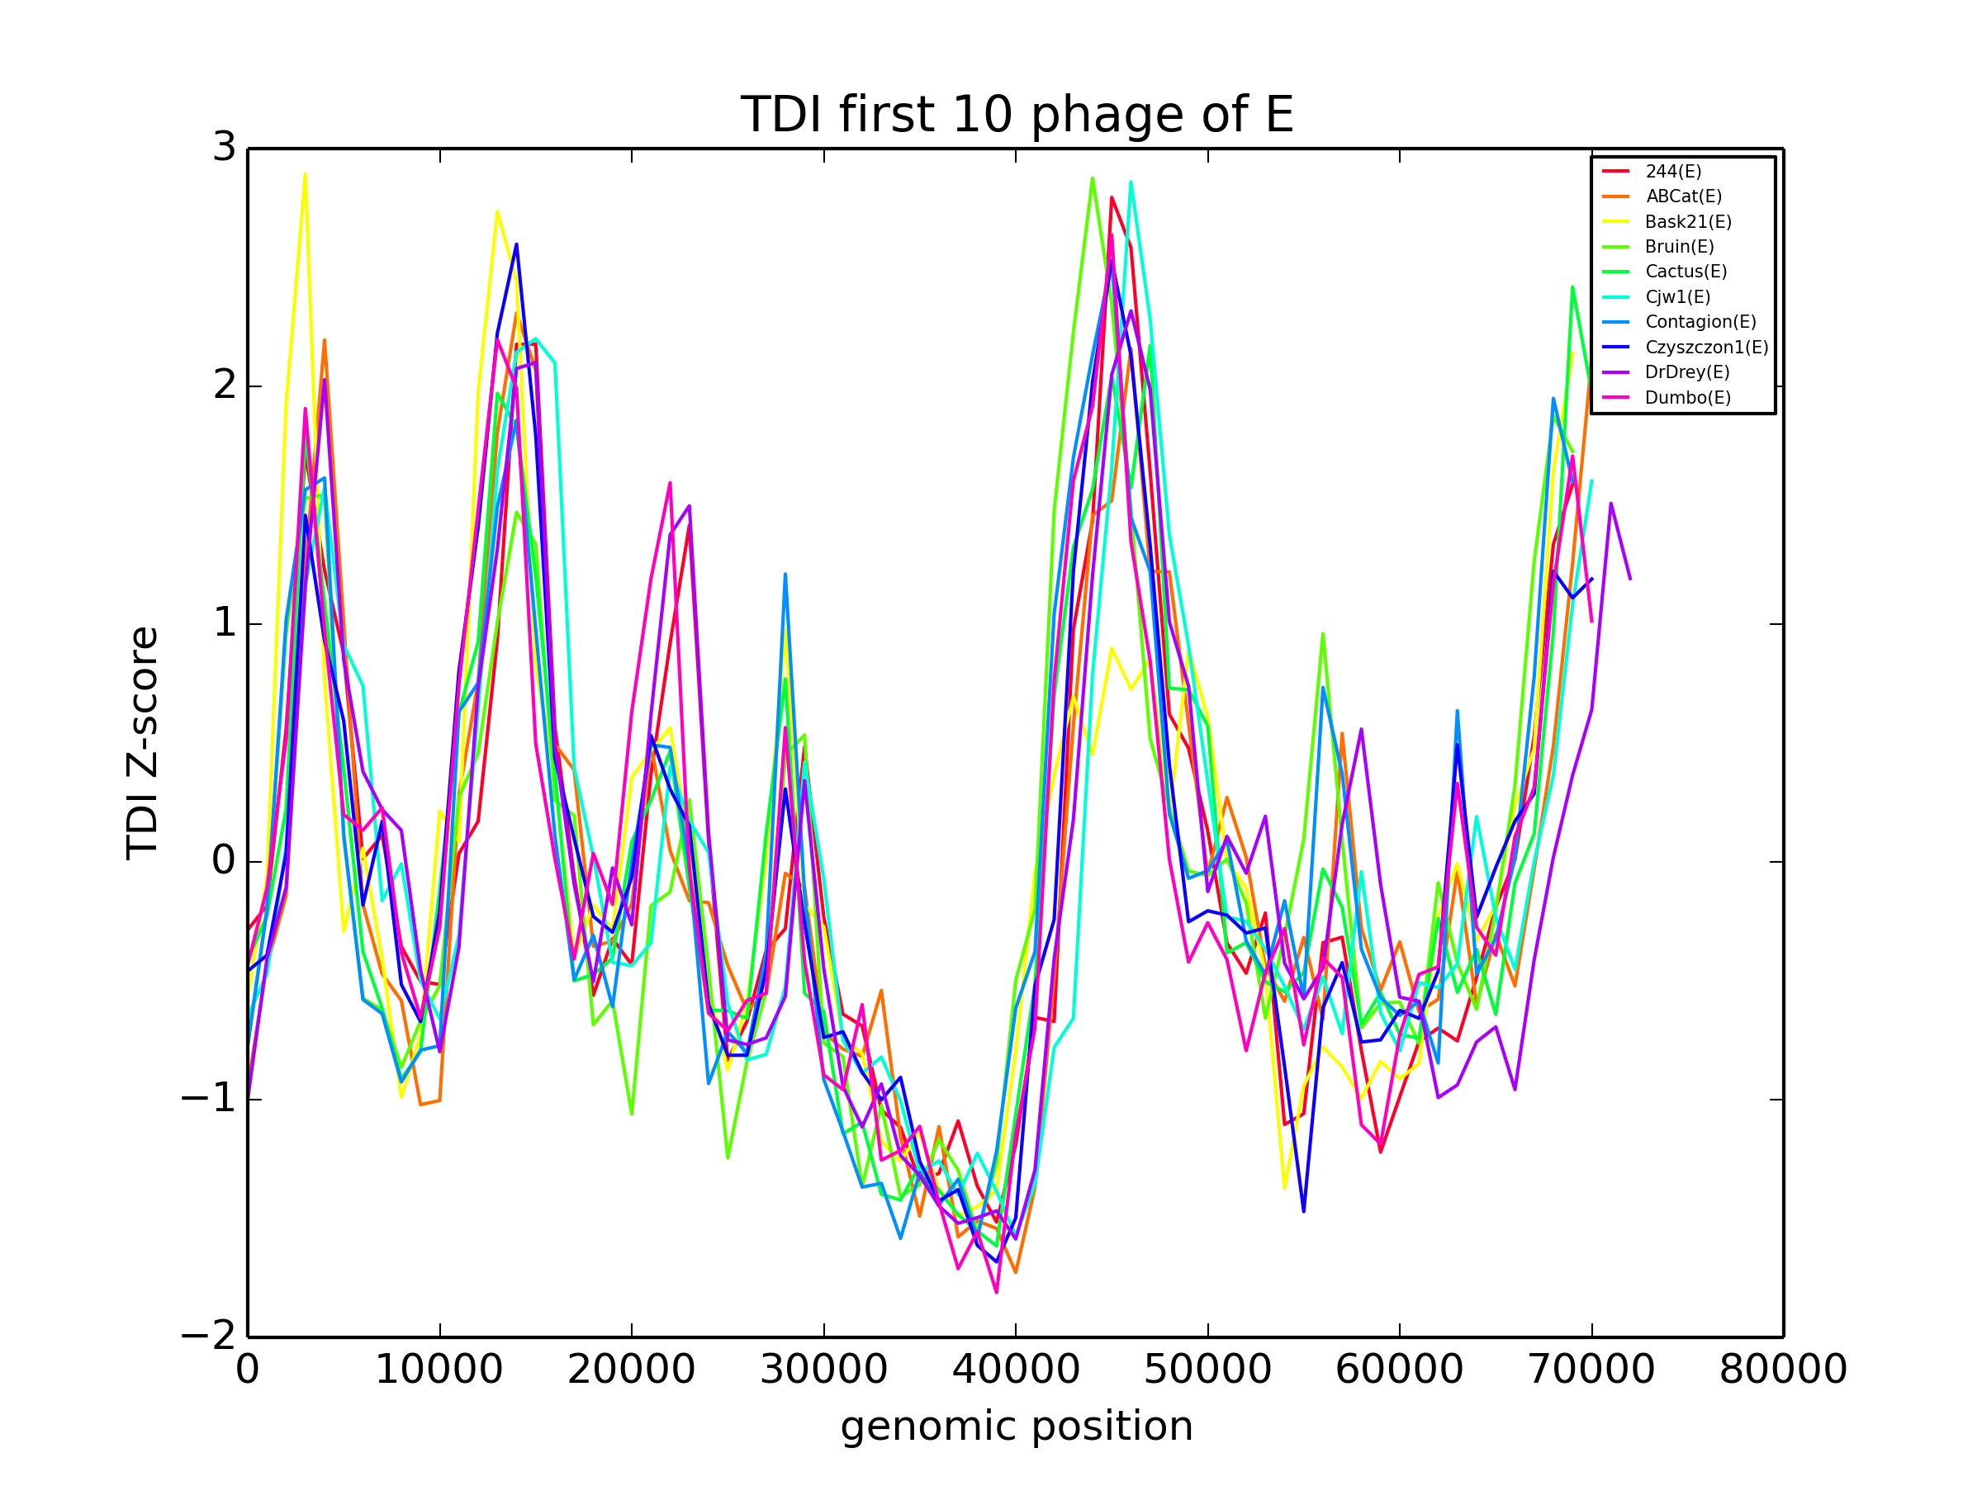

Slide 29
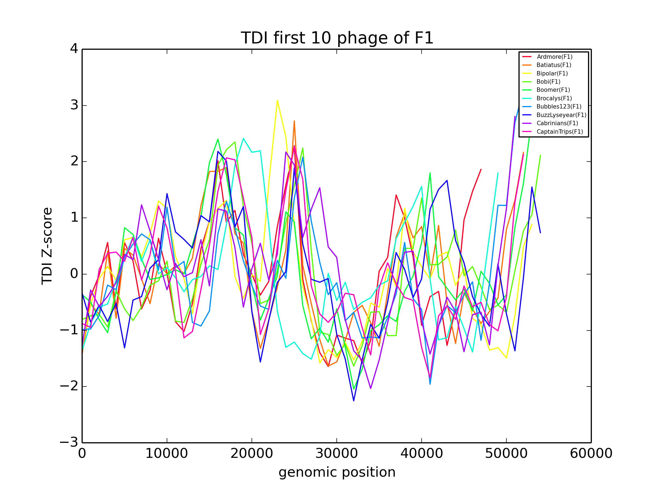

Slide 30
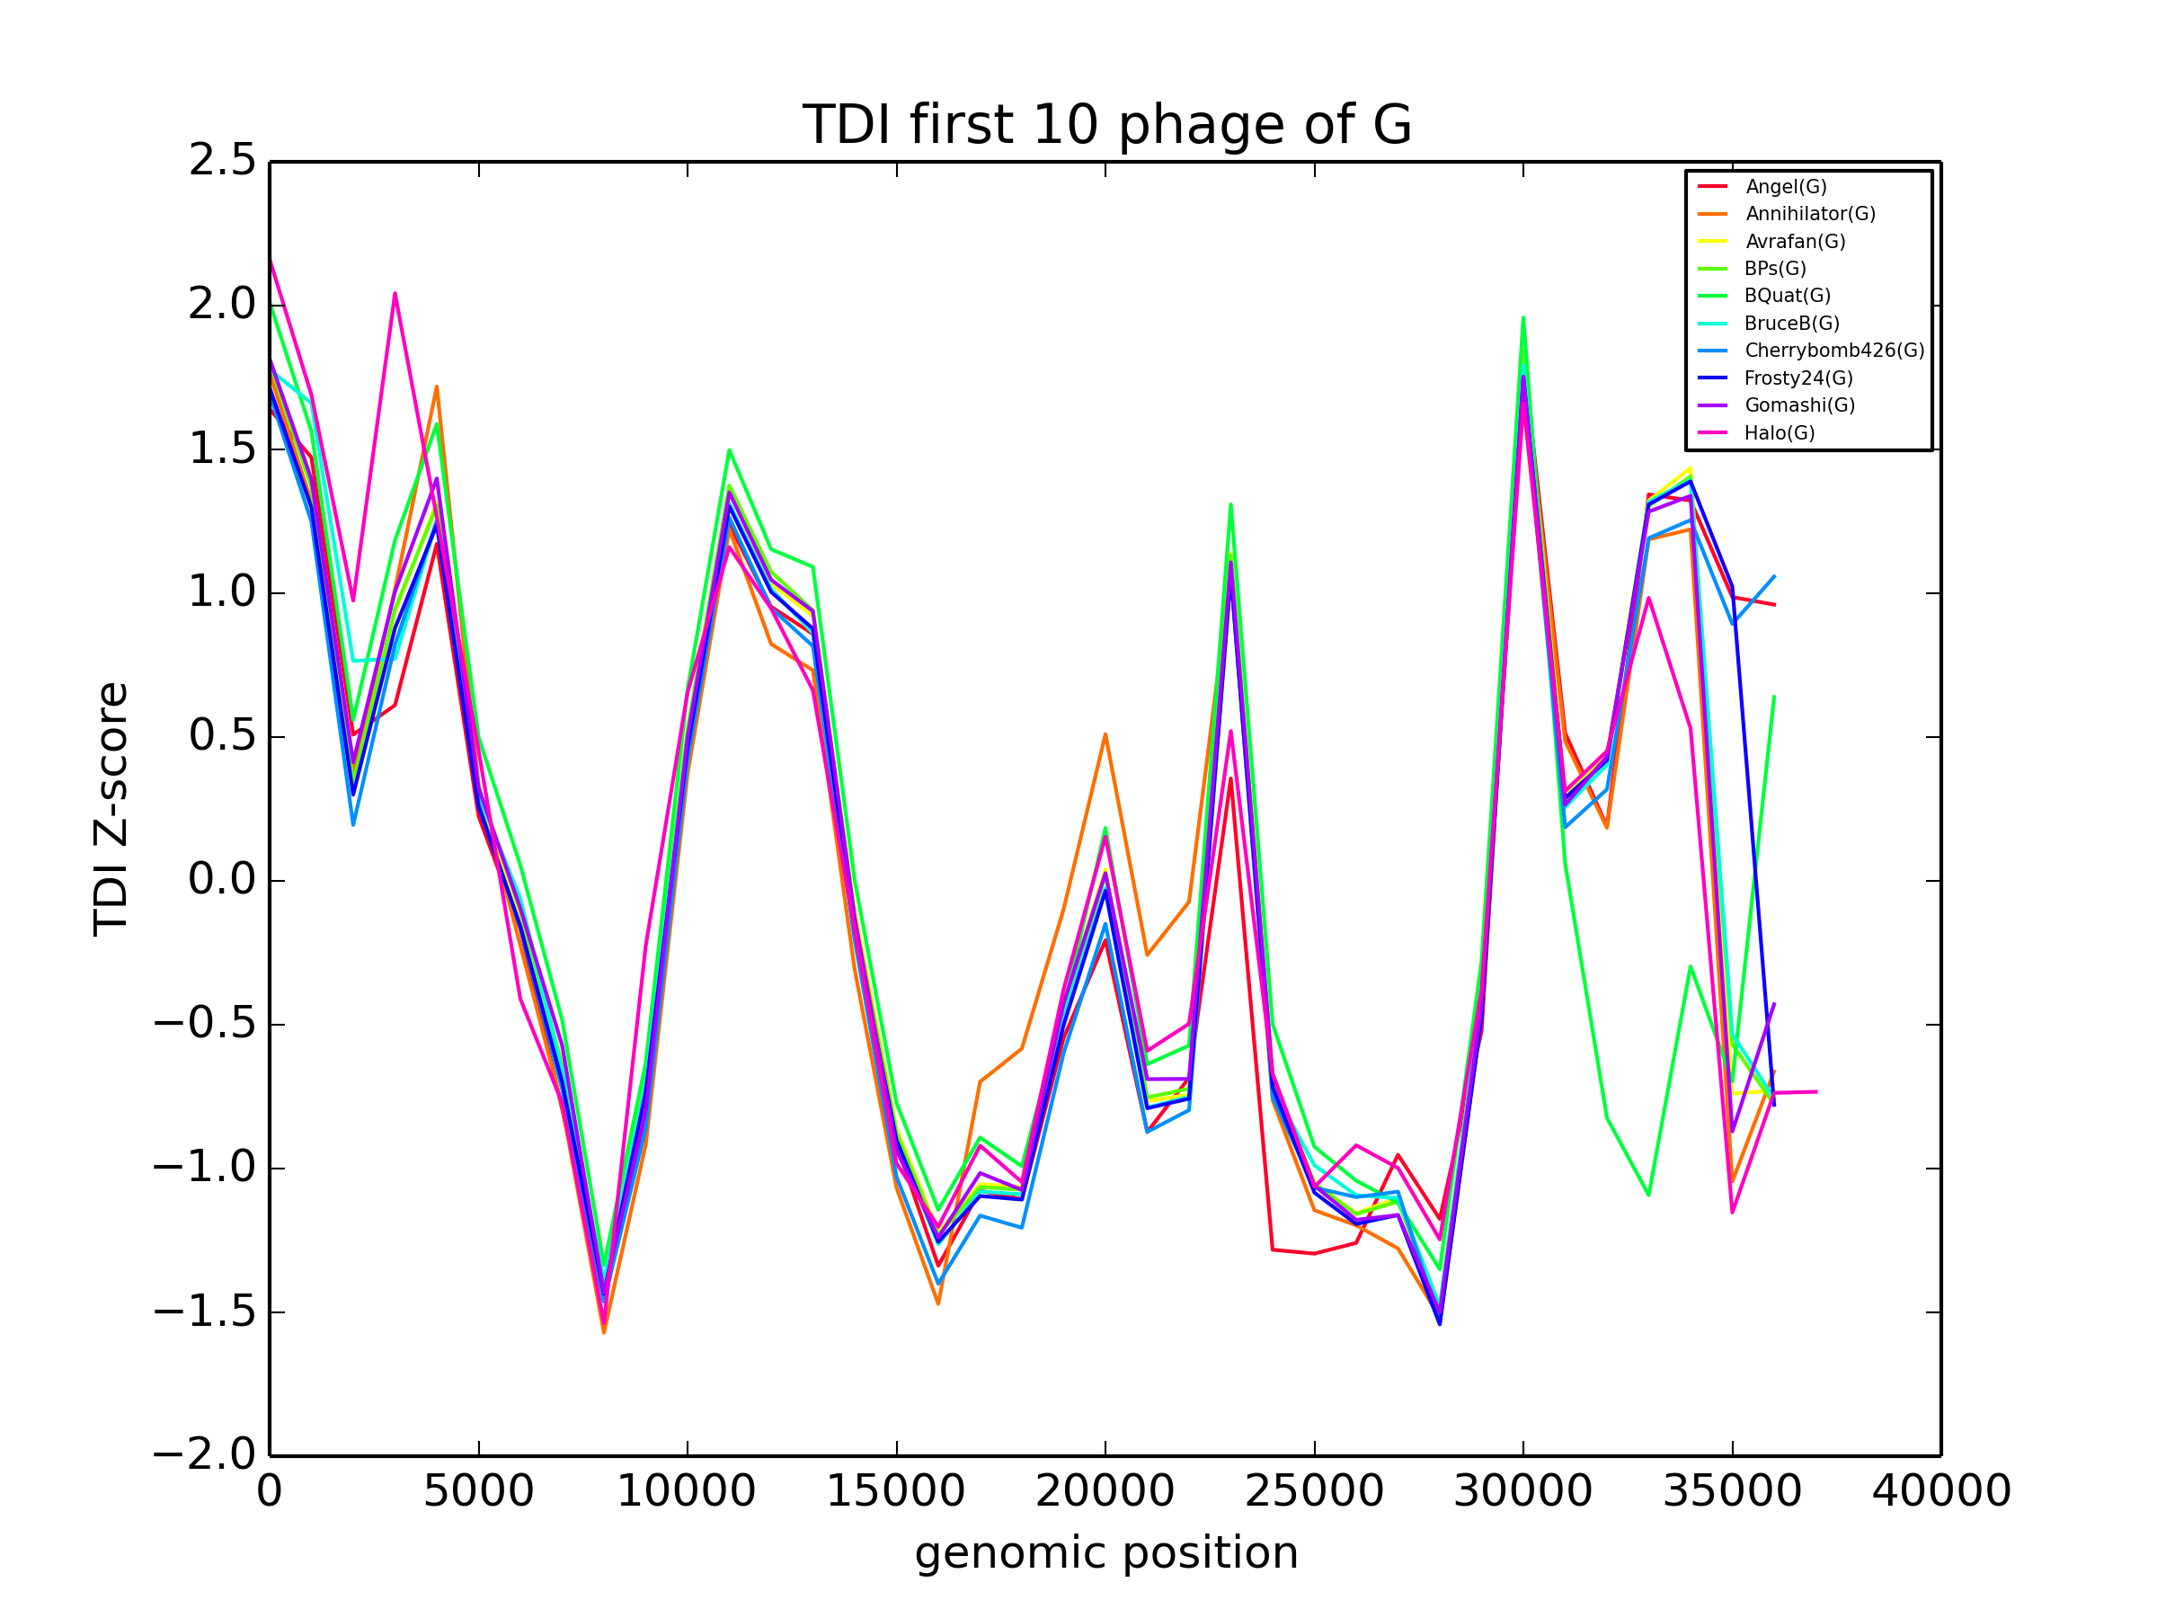

Slide 31
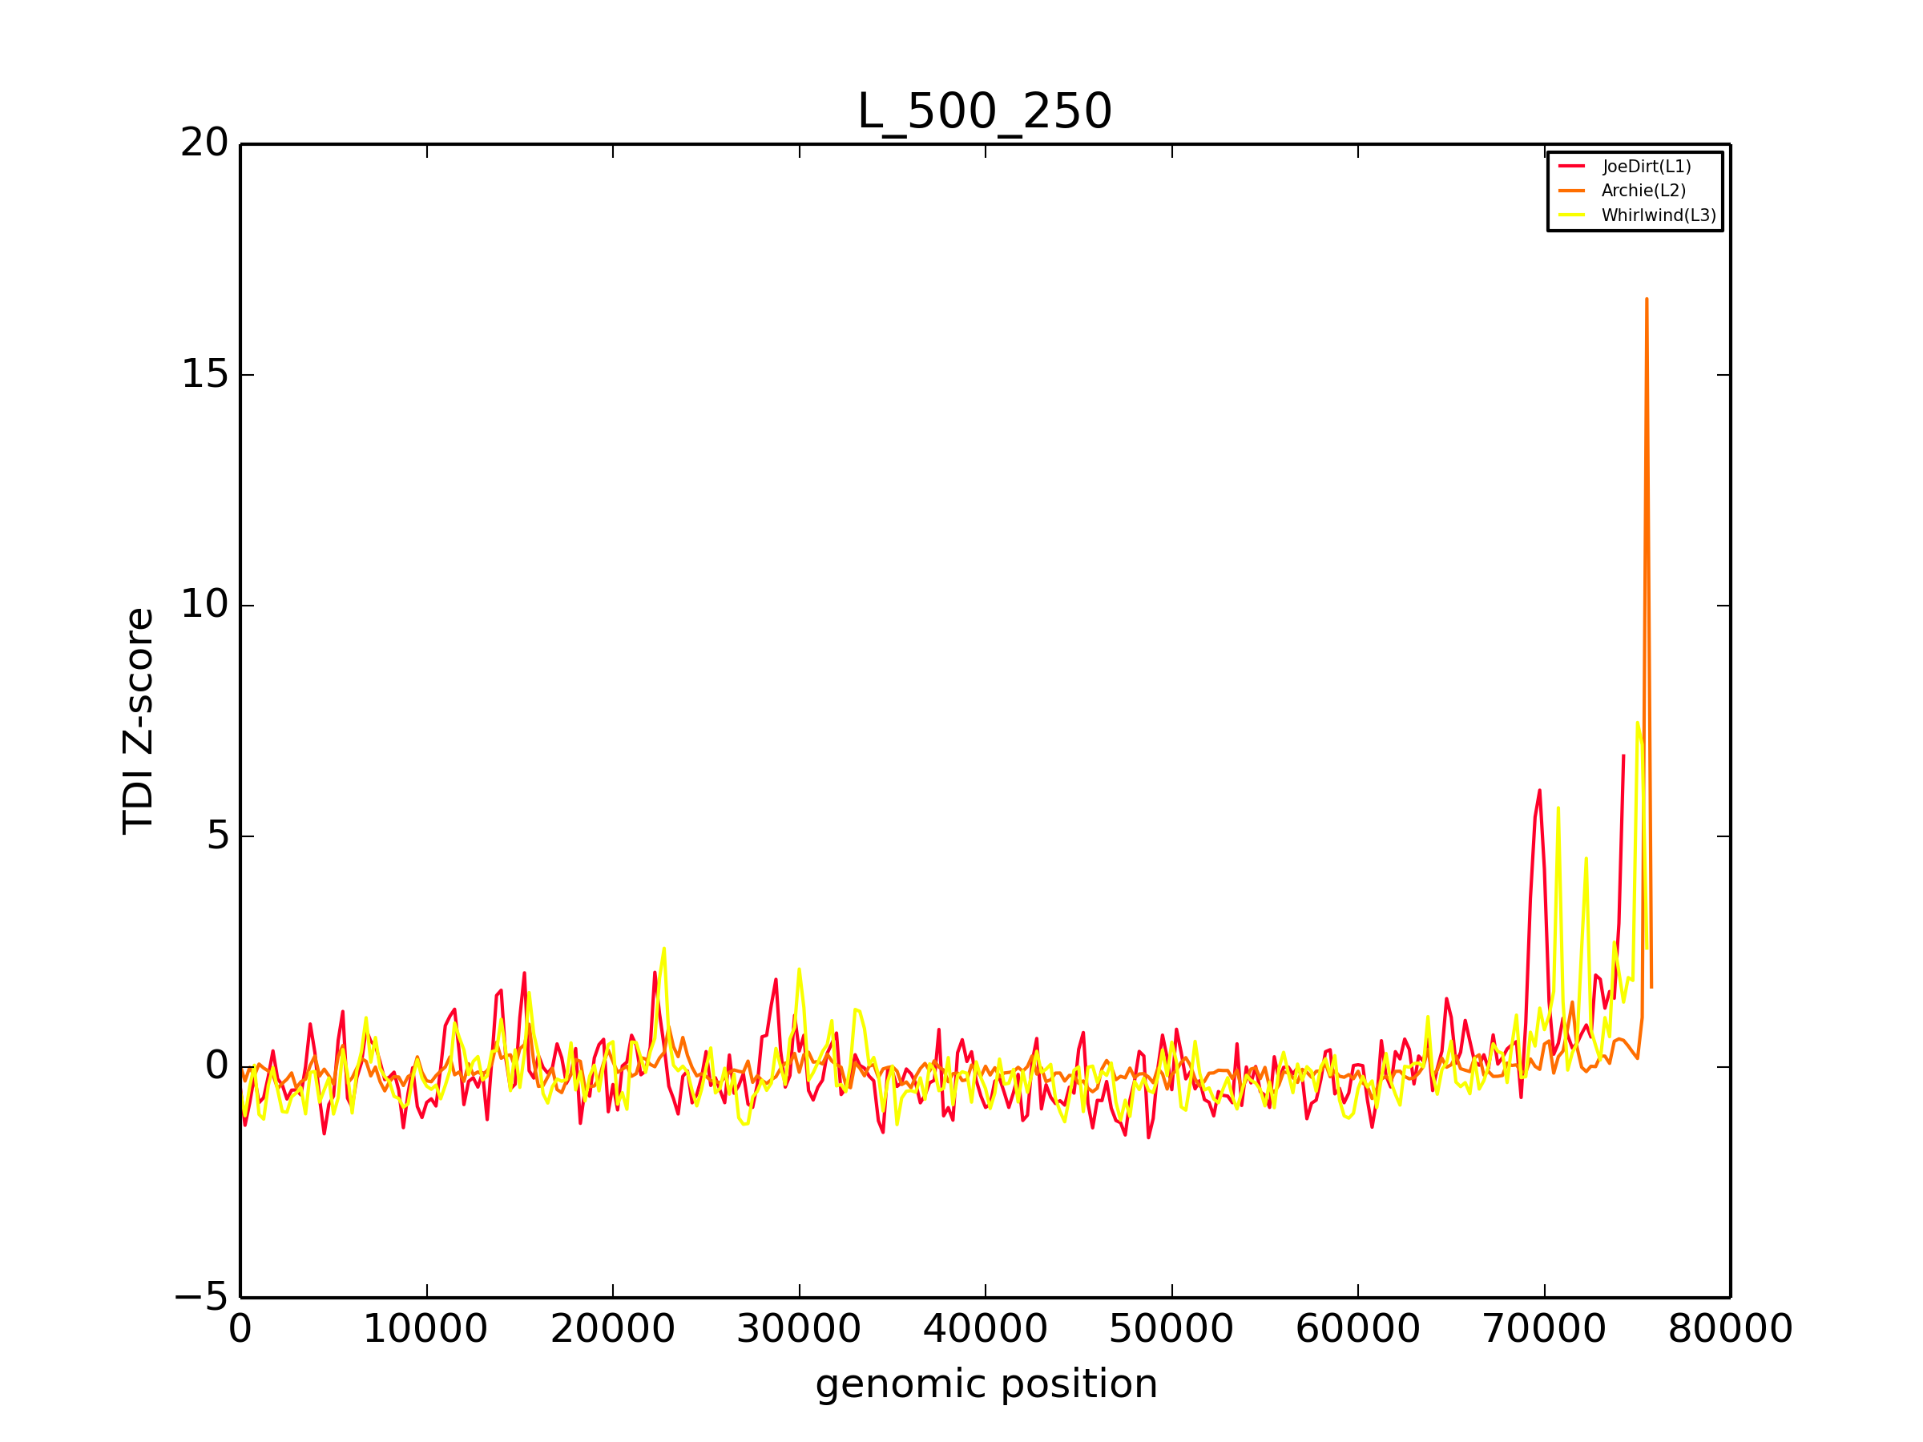

Slide 32
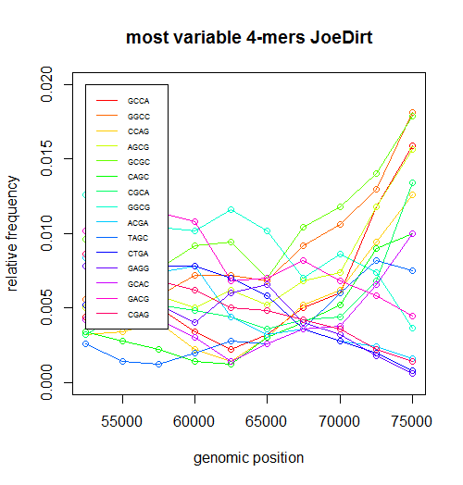

Slide 33
there’s probably more stuff to put here

Slide 34
THANKS
questions?

